Slide 1

are lost per year due to lack of perks knowledge
משפט פתיחה - כאב
5.5 BILLION NIS

Slide 2

Of israeli residents hold at least 2 credit cards (2.5 in average).
Of Israeli credit cards are not used (1.5 mil. cards)
The money that can be saved yearly if the rewards are properly utilized
75%
15%
1,500 ₪
The buying habits of Israelis | Kikar | How many credit card do you need? | Riseup

Slide 3
Who are we?
Yuval Ofek Software Developer at AT&T, 3rd year Computer Science student.
Dan Davidovich
Officer in Flotilla 13 with the rank of major, 3rd year Computer Science student.
Idan Asayag Frontend Developer Student at Elta Systems Ltd, 3rd year Computer Science student.
Lior Hassin 3rd year Computer Science student.
Omer Ben David Software Developer Student at IDF, 3rd year Computer Science student

Slide 4


Meet SwipeAdvisor
Simplifying the card selection

Slide 5
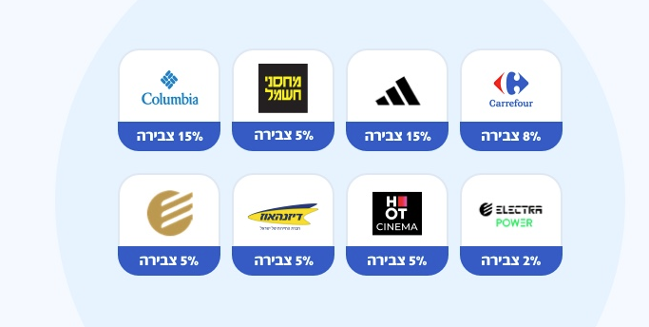
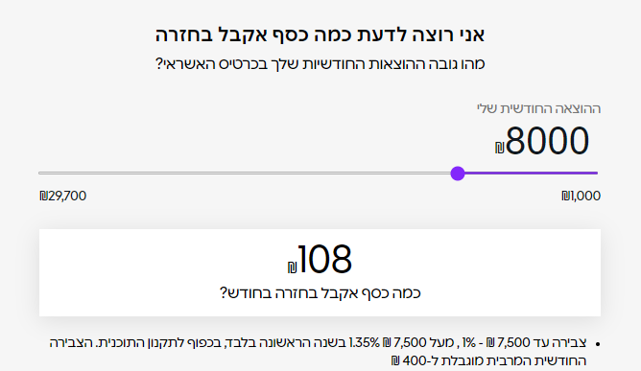
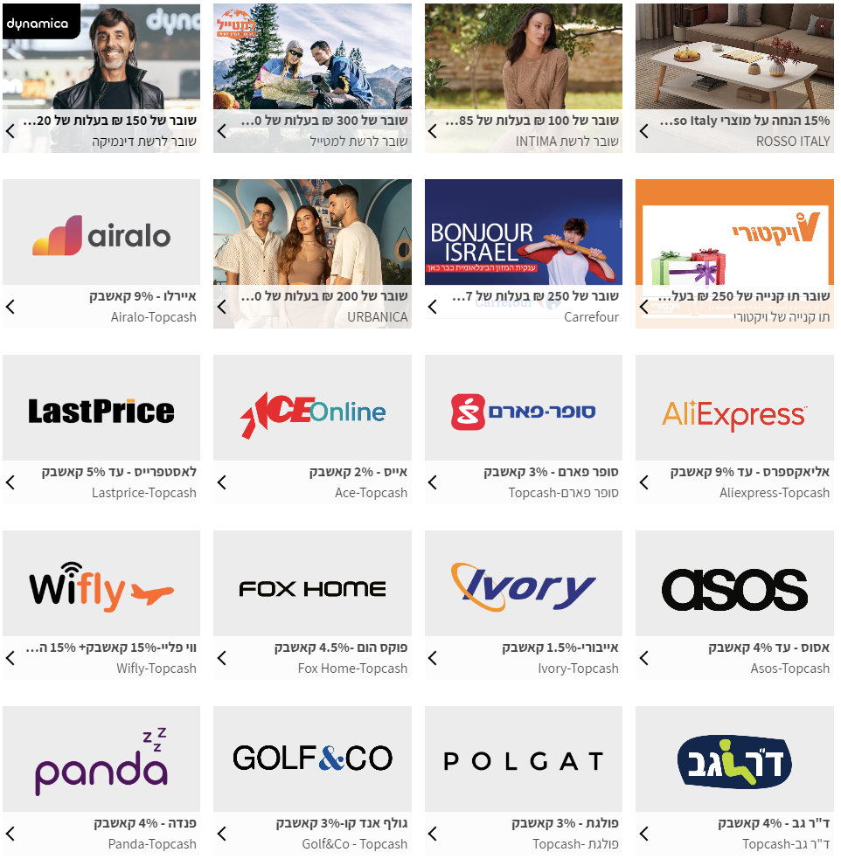
With the multitude of credit cards offering rewards and various benefits, consumers face the challenge of choosing the most profitable card for their specific transaction
Bit (Carrefour) card
Isracard

Slide 6




75% of israelis possess at least 2 credit cards
7.381 million people
1,500₪ saved yearly in average (per capita) if the rewards are properly utilized
11.07B ₪ can be saved yearly

Slide 7

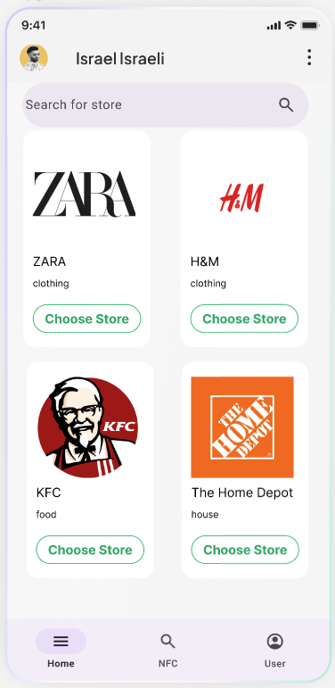



How does it work?
The app will keep the data of benefits within credit cards (both general benefits and specific benefits between credit card to business).
The users can select their preferences (Nominal profit, Lowest price or points, and arrange their preferred cards in a list).
The customer will enter the business name and the transaction amount - and the algorithm will sort the cards from the most profitable to the lowest.
The app includes a premium account with unlimited cards, unlimited recommendation usage, and no ads.

Slide 8
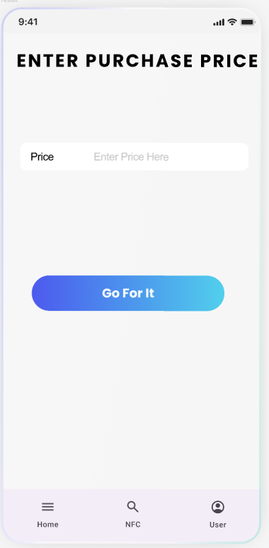
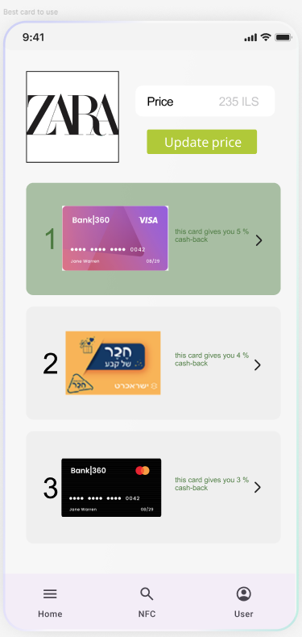
How does it look?

Slide 9



Competition
Google Pay and Apple Pay: Default credit card selections without considering.
Fid: consolidates all the benefits from the user's credit cards and clubs, allowing to view the benefits belonging to each card or club - does not have a recommendation service, nor a user preferences.
WalletFlo: Focuses on post-transaction rewards accumulation, available only in the American market.

Slide 10

Market
In 2023, the scope of spending on credit cards in the Israeli economy reached an amount of more than NIS 465.987 billion, an increase of 5.22% compared to 2022. Spending in online transactions on Israeli websites reached 267.406 billion NIS.
About 75% of israelis possess more than one credit card - amounts to approximately 7.381 million people.
2.5 is the average number of cards for every person who uses credit cards.
Around 56% of Israeli credit card holders reported actively using the rewards associated with their credit cards.
*How Do Consumers Feel About Credit Cards?

Slide 11

Join us in our mission to help millions save money on every transaction.

Slide 12
As of 2023, 75% of Israel residents hold at least two credit card with an average spends of 150,000 per year.
What if I can save you with a 7 seconds at the
7 מתוך עשרה יכולים לחסוך כ3000 שח בשנה ללא כל מאמץ
Isracard

